Slide 1
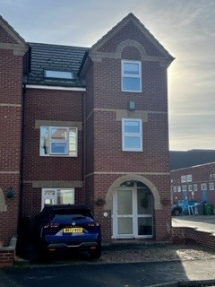

Welcome to Felix house
CF social work
Felix house
Children’s Guide
Written by Jerome Laidlaw
CF Children’s Homes
July 2024
BE SAFE BE KIND BE HAPPY

Slide 2











Welcome to Felix house
Our Location
CF social work
Felix house
Children’s Guide
Welcome to Felix House At Felix House we understand that moving to a new home can sometimes be frightening or scary, so we have put together this guide to give you an idea of what it is like living at Felix House. It tells you what you can expect when you arrive. We hope that you enjoy your time here and we aim to help you in any way we can.
At Felix House we believe that you can aspire to be anything that you want to be! About Felix House Felix House has bedrooms for 2 children or young people aged between 6 – 13 years old. It is situated in the town of Felixstowe which is a short walk from the beach, the amusements, and the seafront.
BE SAFE BE KIND BE HAPPY

Slide 3
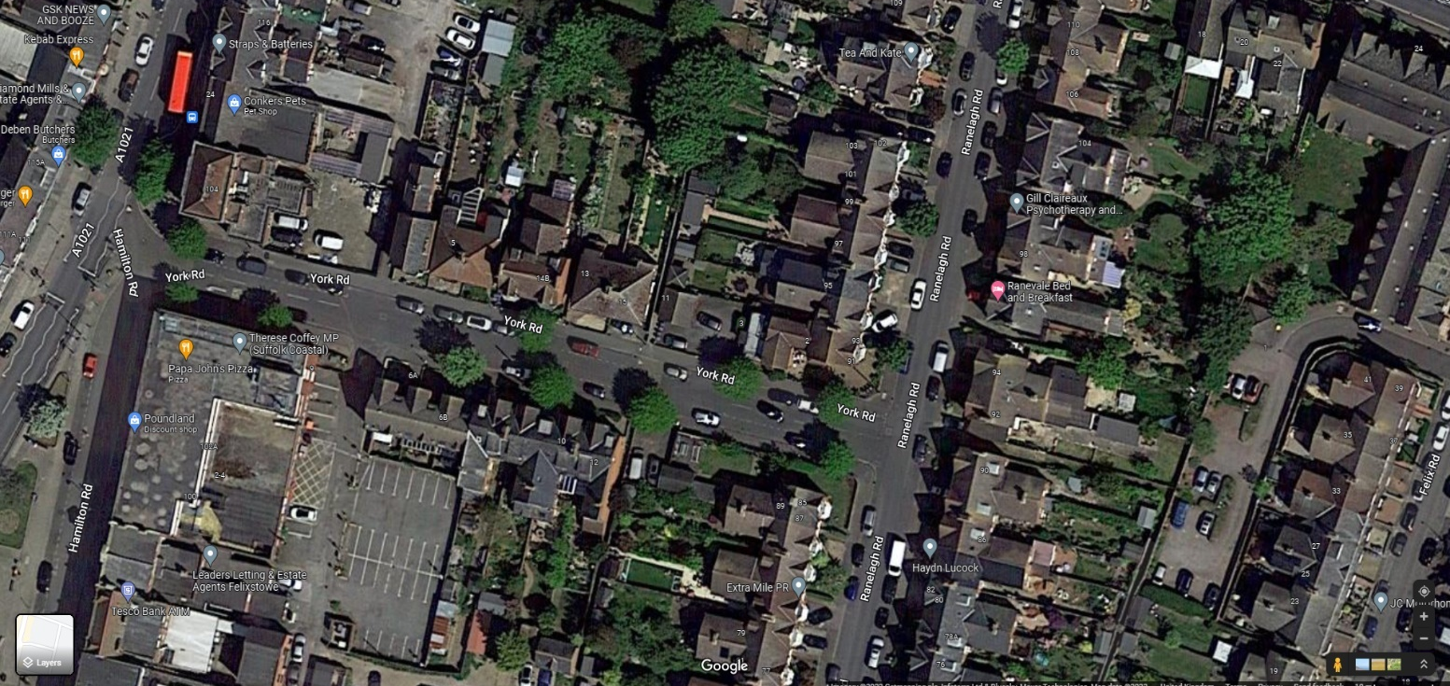
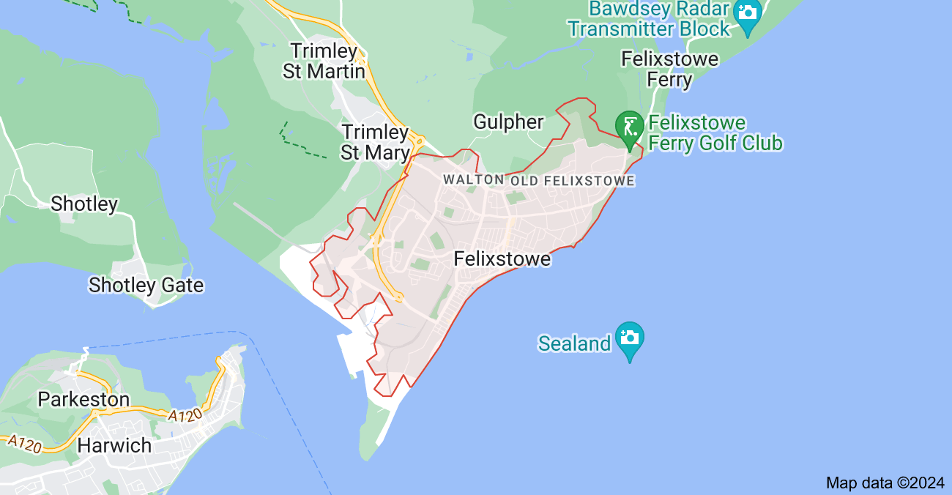

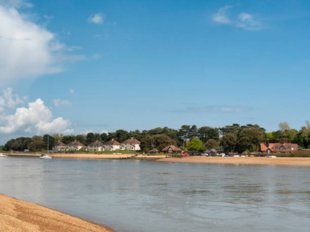

Welcome to Felix house
Our Location
CF social work
Felix house
Children’s Guide
The home is in the small seaside town of Felixstowe, within walking distance of the beach and the countryside.
BE SAFE BE KIND BE HAPPY

Slide 4

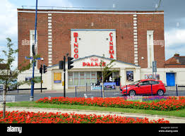

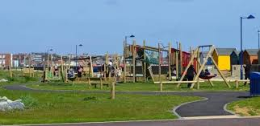

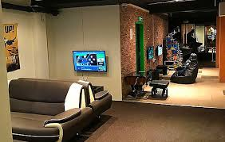

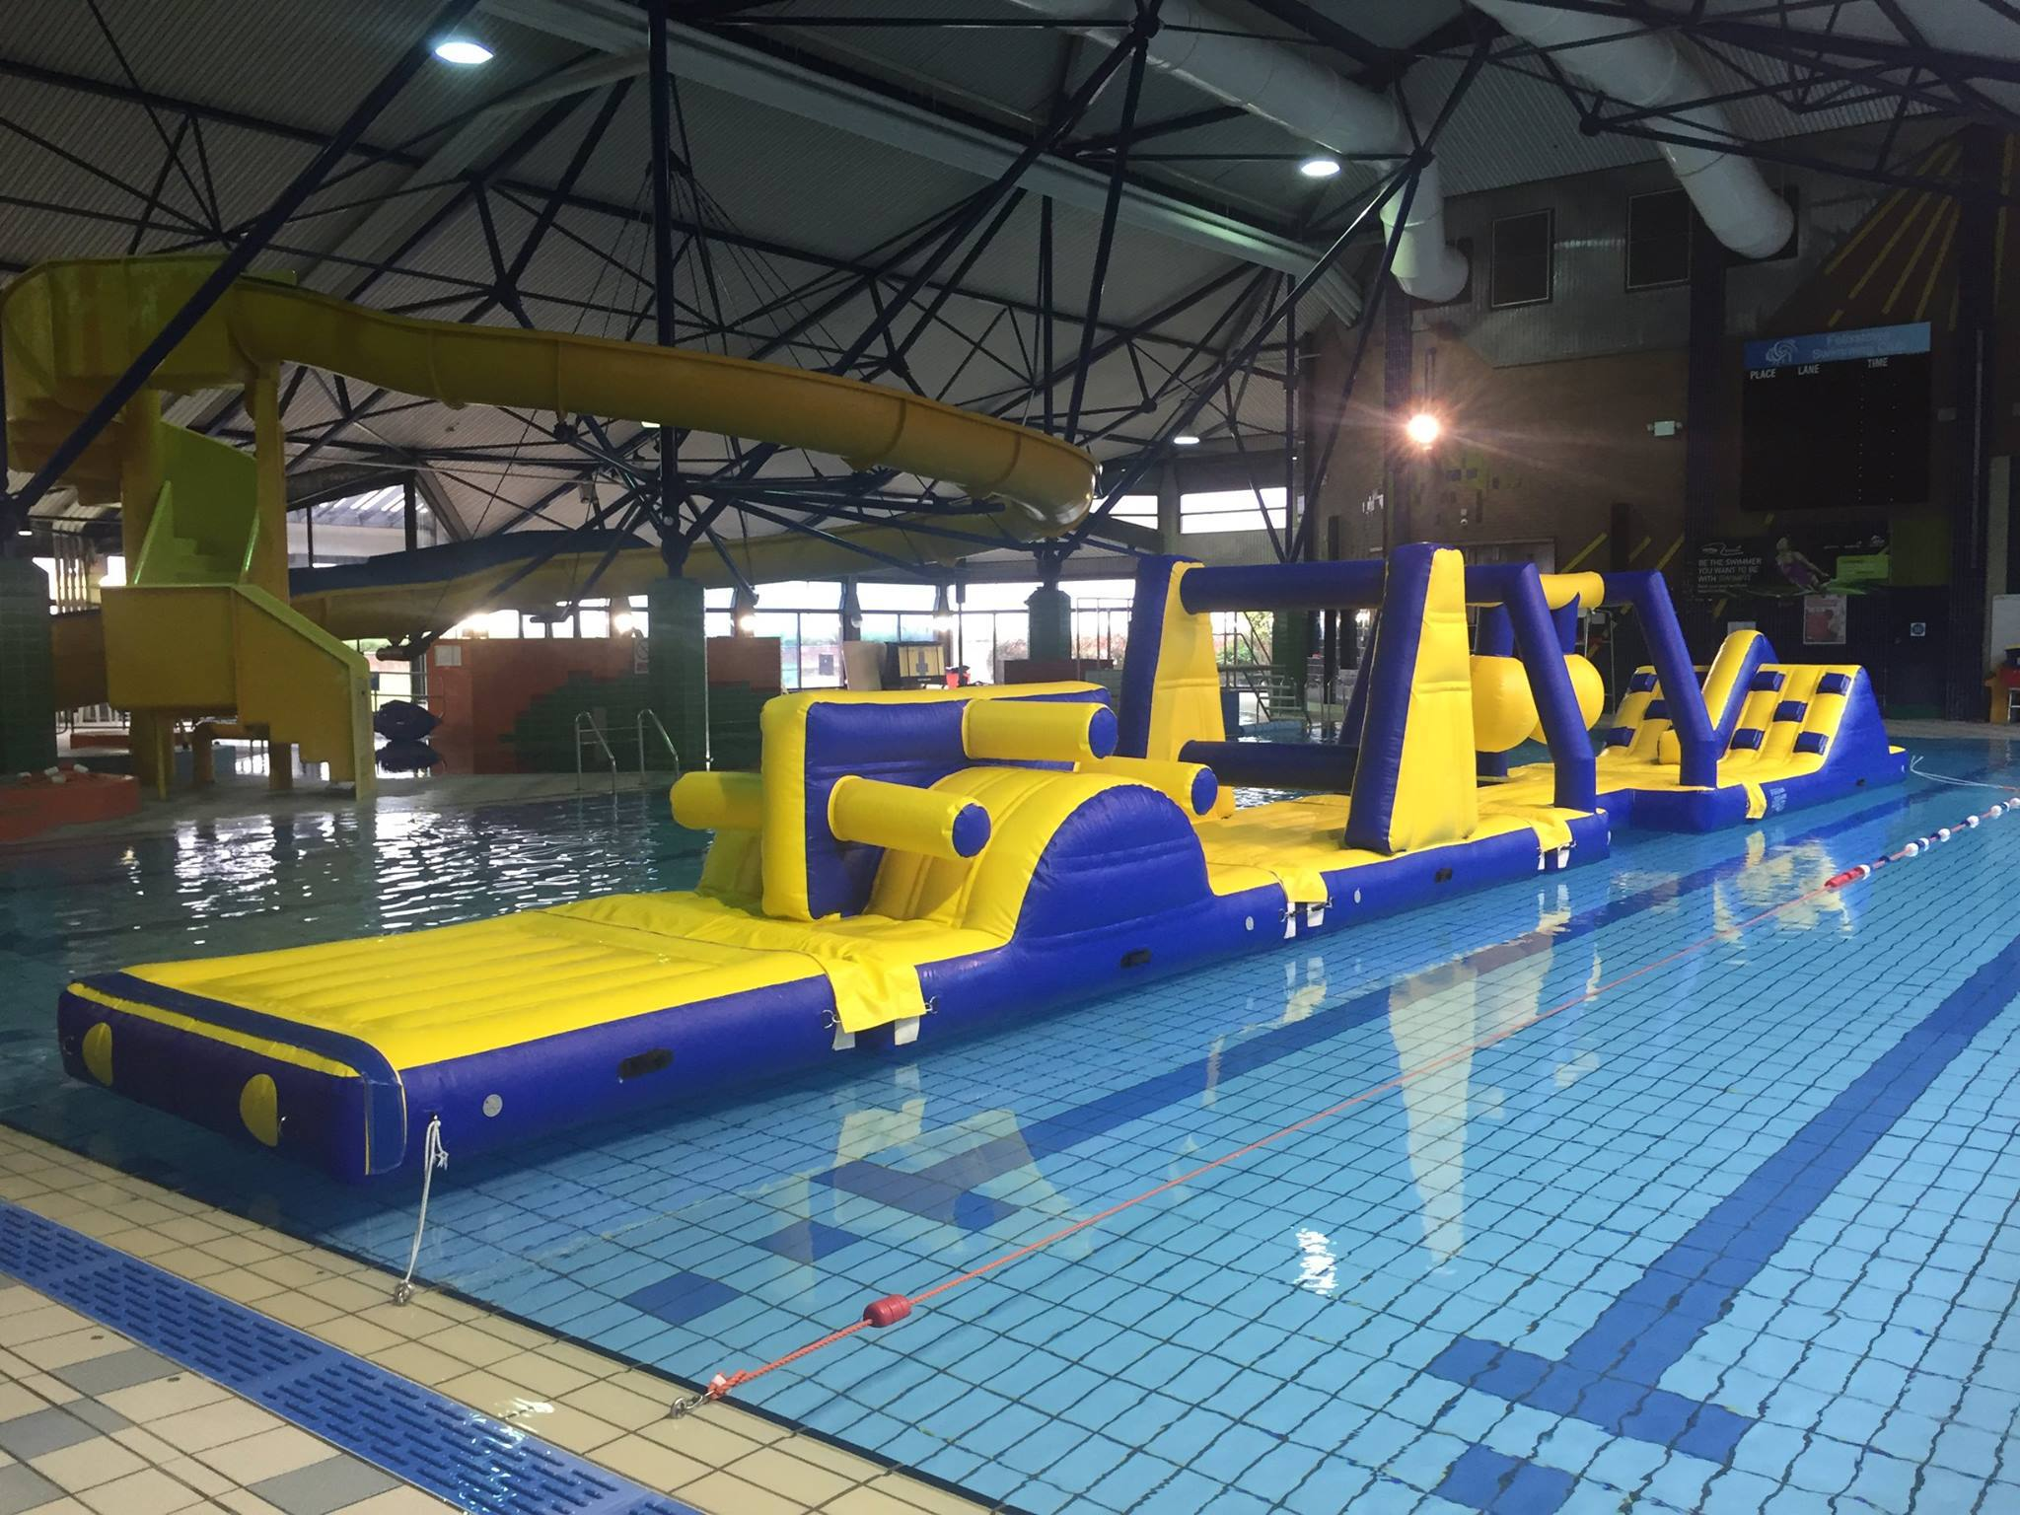


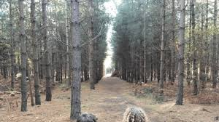


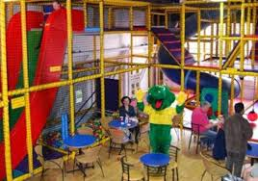
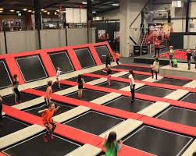







Our Location
CF social work
Felix house
Children’s Guide
In our area you will find schools Primary and High schools.
We are also just a short drive away from Ipswich where there are indoor trampoline centres, a dry ski and tobogganing slope and indoor rock-climbing parks as well as shops and parks.
Football clubs, a swimming pool with slides, cinema, a sports centre, roller skating, horse riding, golf club and lots of parks and forests to ride and play and look for Pokémon and hidden spaceships.
Local shops to buy your favourite sweets and treats / amusements on the sea front and the pier.

Slide 5




Welcome to Felix house
Your Faith and religion
CF social work
Felix house
Children’s Guide
If you follow a religion, we will be happy to make sure that you can go to your place of worship. We fully understand that this will be important to you. If you need a special diet because of your religion, dietary needs or because you are vegetarian, we will do our very best to help you eat healthily whilst providing you with food in line with your needs.
BE SAFE BE KIND BE HAPPY

Slide 6
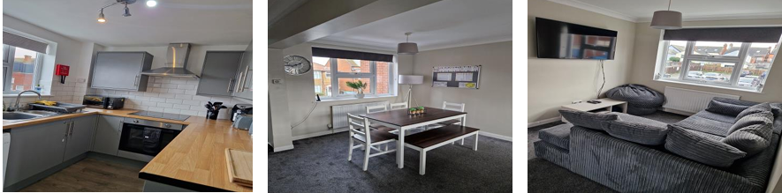
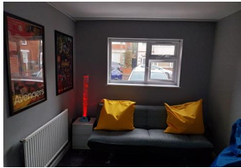
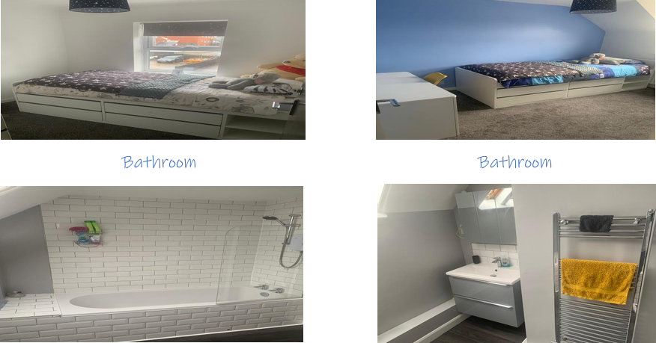
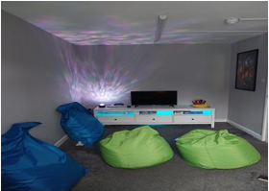
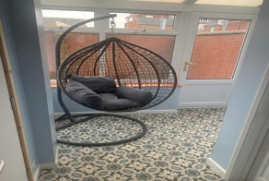

You get to set up your room how you like.
Your home looks like this
CF social work
Felix house
Children’s Guide
First Floor
Ground Floor
Second Floor
Kitchen
Bedroom 1
Bedroom 2
Games Room
Lounge
Bathroom
Conservatory
Dining area
BE SAFE BE KIND BE HAPPY

Slide 7

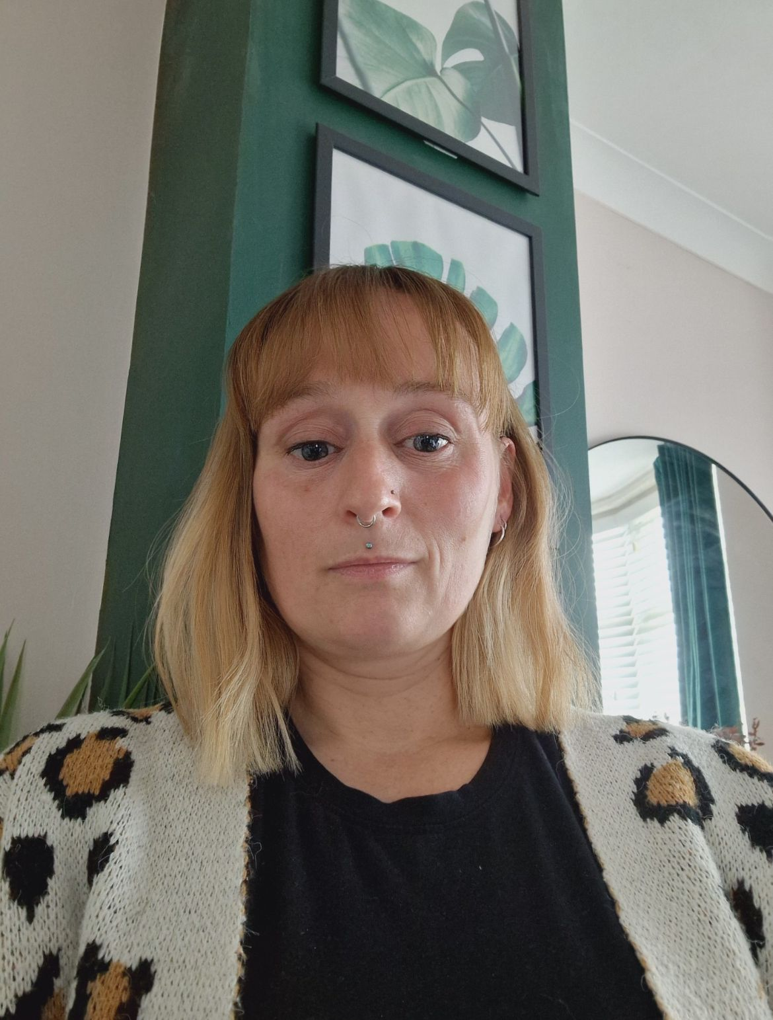


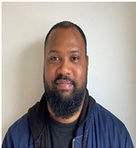


Who will you see in the home
CF social work
Felix house
Children’s Guide
Residential Support Workers
Jackie
Kerry
Taquan
Holly
Senior Residential Support Team
Jerome
Natalie
Katie
BE SAFE BE KIND BE HAPPY
Homes Manager
Senior Support Team
Senior Support Team
Senior Support Team
BE SAFE BE KIND BE HAPPY

Slide 8


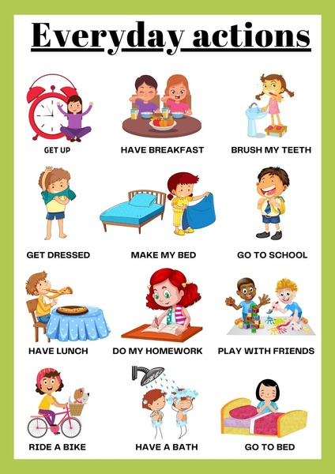


Routines of the home
CF social work
Felix house
Children’s Guide
At the home, the days are structured and planned because everyone needs a routine, and so we provide that for everyone at the home.
We have getting up times and going to bedtimes, just like in any family home. In the evening, we want to make you feel settled, calm, and safe, so we have 'Settling Time' where a carer spends time with you (if you want them to). Carers can play cards, talk, reflect on the day or read you a book.
Carers will do all they can to help you settle for the evening feeling safe and comfortable.
BE SAFE BE KIND BE HAPPY

Slide 9


Settling Time
CF social work
Felix house
Children’s Guide
Settling times vary according to your age.
Whatever your age, we do allow you to stay up a little later at the weekend as you do not have to get up for school the next morning.
You are not allowed in each others bedroom with the door shut, so carers will be there at all times if you are in each others room.
Our weekday settling times are:
BE SAFE BE KIND BE HAPPY
6-year-olds 7pm
10 year olds – 8pm
7–9-year-olds –7.30pm
11 & 12-year-olds – 8.30pm
Weekends will be 30 minutes later.

Slide 10
Activities
CF social work
Felix house
Children’s Guide
We will encourage you to do activities at Felix House and these would be part of your routine/plan when you are not in school. Here are some examples of activities we can offer you
Swimming
Country Walking
Horse riding
Cycling
Youth Groups
Scouting
Gym
Go-Karting
During the school holidays we plan extra activities which might be further away – perhaps a day out in London or a trip to a theme park.
Cinema
Days at the Beach Felixstowe On the pier
Joining a boxing club
Joining a Football team
We would love you to take up a hobby or an activity each week and we provide up to £30 each week for you to spend on this.
We plan the meals a week in advance, and we want you to be a part of this All children are expected to attend school or an educational provision between Monday and Friday during term times.
BE SAFE BE KIND BE HAPPY
If that is not possible then the you are expected to do some educational activities with one of our carers whilst a school or new place of education is being found

Slide 11

Free Time
CF social work
Felix house
Children’s Guide
Anyone who is of primary school age will not have free time and will be to be looked after by a Carer at all times.
If you are 11 or 12 years old, you might have some free time but this will depend upon what your Social Worker thinks and whether we think that you can keep yourself safe in the community, but this is something that we can work towards if it is safe to do so
BE SAFE BE KIND BE HAPPY

Slide 12

Pocket Money
CF social work
Felix house
Children’s Guide
You will receive your pocket weekly on a Saturday morning after you have made your bed or helped with a chore around the house with a Carer.
You will also spend your pocket money with a carer so they can help you spend your money appropriately.
Clothes Allowance and Toiletries Each week you will be entitled to a clothing allowance. The basic weekly allowance we provide is:
£17 per week for people under 12 years of age.
Each week you will also be entitled to a toiletries allowance. The basic weekly allowance we provide is £5 per week.
You will go shopping with a Carer who will look after the money and spend to buy what you need. It can be spent each week or saved up and spent as a larger amount.
The team will keep a total of how much of both these allowances you have available to spend.
Pocket Money You will receive your Pocket money each week.
5-8 years: £3.50
9-12 years: £5.00
BE SAFE BE KIND BE HAPPY

Slide 13





Pocket Money
CF social work
Felix house
Children’s Guide
Christmas and Birthday Money We have a set amount of money that we make available to you to select a birthday present and to select a Christmas present. Rather than giving you cash as a present we prefer to buy a nice gift which you can choose if you wish. We feel this will create fonder memories for you if we don’t think the gift you want is appropriate, we may need to speak to your social worker for them to approve.
BE SAFE BE KIND BE HAPPY

Slide 14
Keyworkers
CF social work
Felix house
Children’s Guide
One of our Carers will be your Key Worker. A key worker is someone you can ‘go to’ if you need anything answered. They will help you understand your feelings and have a good idea of what your needs are. They will sometimes attend meetings for you and with you, and Steve will also do this. We have a lot of paperwork that needs to be kept up to date, and your keyworker along with Steve will make sure all your paperwork is kept up to date, so that we can all work together effectively to meet your needs.
You will be told who your key worker is before moving in and the manager will arrange for you to meet them before moving in too. They will ensure you keep appointments, liaise with your school and any family members. They will ensure you have clothing, toiletries and they'll meet with you weekly to discuss how your life is at that moment and give you a chance to share any worries you may have.
BE SAFE BE KIND BE HAPPY
Jackie
Kerry
Taquan

Slide 15





Education
CF social work
Felix house
Children’s Guide
We expect all the children living at the home to attend school or do whatever educational activities have been set up for you each day. We will support you in any way we can, and we will be there to help you. If you find attending education difficult, we will encourage you to attend as well as finding out the reasons why it is difficult for you.
If you refuse education, there may be consequences put in place, but we will also find out why you don’t want to attend. It may mean that you miss an activity in the evening, but We will always explain what will happen before decisions are made. This will give you the chance to change your decision and make good choices.
BE SAFE BE KIND BE HAPPY

Slide 16
Living at Felix house you can expect too:
CF social work
Felix house
Children’s Guide
To be listened to and have your wishes and feelings taken into consideration.
To attend meetings which are about you and, if you wish, be accompanied by a person with which you feel safe with and who you trust.
You can have an advocate if you would like one.
You will not to be discriminated against.
To see and discuss reports and records written about you.
To have future plans written in a way that you understand.
To make a complaint and know you will be taken seriously.
Your privacy will be respected.
To be respected always and to have help overcoming any difficulties.
To feel safe within the home and to be fairly treated.
To be able to stay in contact with family and friends and carers where possible where it’s safe to do so.
To be told how much pocket money you are entitled to.
To be involved in buying your clothes if you wish.
To have the correct preparation when leaving Felix House.
To be protected from bullying and other difficult relationships. 16. To understand how to keep yourself safe when using the internet/social media
BE SAFE BE KIND BE HAPPY

Slide 17




Your Say / Your voice is important
CF social work
Felix house
Children’s Guide
This is your home. Felix House is a place where we want you to feel safe, happy, loved and understood . We want you to be able to talk to your Carers about any concern or problem you have and how you feel. Felix House is also a place that we want you to have an interest in and have a say in what happens in the Home. That can be about changes to your bedroom or around the home, menus for dinner, how you are feeling about your care, days out, holidays, about things we expect of you and of things that you expect of us.
You can share your views with your carers and the manager at any time during the day – whilst sitting down to eat or just in passing. There are also set times where you can have your say – and those are during keywork sessions and during House Meetings, or even just asking the carer if you could privately speak to them. We will also ask you what your views are of the home, in a questionnaire we issue to all young people every three - six months. We want your views as they are important! We want to build with you and work with you to help you feel settled and relaxed in your home setting.
BE SAFE BE KIND
BE HAPPY

Slide 18
Complaints – We want to know
CF social work
Felix house
Children’s Guide
If you feel you need to make a complaint about someone or something, tell a member of the team. This can be recorded on a ‘I want you to know form’ which a Carer will help you to complete. You can give this to the manager, and they will help resolve the issue for you. The manager or your keyworker will always let your Social Worker know as well.
If you are not happy with the response, you can speak to the Responsible individual for the Children’s Homes and your Social Worker, the home will provide this information to you.
There is also a person who visits the home each month. This person is known as our Regulation 44 independent visitor. On each visit she will probably ask to speak to you. You can speak freely to her. They will ask your opinion on how you are being looked after, and whether you have everything you need. If there is anything else you wish to make a complaint about and do not want to tell your carer or the manager, then you can phone any of the following numbers:
• Your social workers – their number can be provided for you
• Ofsted, Building C, Cumberland Place, Nottingham, NG1 6HJ Tel: 0115 944 9084
• Childline - 0800 1111 • NSPCC - 0800 800 500
• Help at hand service - 0800 528 0731 from 9am to 5pm, Monday to Friday (secure voicemails can be left outside these hours).
BE SAFE BE KIND BE HAPPY
Emailing options
help.team@childrenscommissioner.gov.uk
Visit Online: Childrenscommissioner.gov.uk

Slide 19
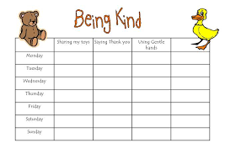
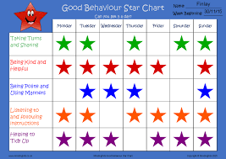
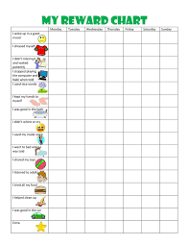

Rewards for positive behavior
CF social work
Felix house
Children’s Guide
You can earn rewards every day. You will have a Positive Reward chart, and you can receive a tick on your chart for each time you do something positive in the home e.g., put your cup away, being polite, help to tidy up and for good behavior.
When you get 40 ticks you will receive a voucher of £10 or an activity of your choice…. You can save the vouchers or activity money up for something that may be more expensive. Your keyworker will help you with this. Depending on your age we also have an Incentive scheme. We have a few options, so, we can all decide which is the best incentive for you.
We will talk to your Social worker before you move into Felix house to make sure it’s the right one for you. We will then explain to you when you visit the home or when you move in.
BE SAFE BE KIND BE HAPPY

Slide 20


Bullying
CF social work
Felix house
Children’s Guide
If somebody physically hurts you, or verbally abuses you, that’s bullying or peer on peer abuse Specific types of bullying include:
• homophobic bullying based on your sexual orientation
• racist bullying because of your skin colour or ethnicity
• religious bullying because of your beliefs or faith.
• sizeism bullying referring to your body size
• cyberbullying targeting you online, often anonymously
• bullying because you are different
Bullying can be a one-off or it can go on for a long time. And bullying can happen to anyone. Ignoring bullying won’t make it go away. You need to tell someone about what is happening.
BE SAFE BE KIND BE HAPPY

Slide 21
Bullying
CF social work
Felix house
Children’s Guide
If the bullying is happening at your school Talk to your parents or carers and your teacher. Your teacher may have no idea that you are being bullied, and the school will have an anti-bullying policy to tackle it.
If the bullying is happening in the home Talk to the manager, your key worker, your social worker or any member of the team. Complete an ‘I want you to know’ form and give it to a member of staff, close relatives such as grandparents, aunties and uncles, or even your friends’ parents. Living in a children’s home environment can be difficult for children which can cause some negative behaviour. So, it’s important your feelings and views are listened to and acted upon, which we will do, we will always be open and honest about what is said.
If the bullying is happening online Tell a trusted adult either within the home or outside of the home – at your school perhaps or your social worker. You can also report abuse to CEOP (Child Exploitation and Online Protection Centre). Keep reporting bullying until it stops. It may not stop the first time you someone and they try to stop it. If the bullying continues, tell them again. Don’t put up with it. No one deserves to be bullied.
BE SAFE BE KIND BE HAPPY

Slide 22
Useful Telephone Numbers
CF social work
Felix house
Children’s Guide
Childline - 0800 1111 You can contact Childline about anything.
Missing Persons Hotline – 116 000 If you have been affected by a disappearance or you have information about a missing person.
Help at hand service
By calling 0800 528 0731 from 9am to 5pm, Monday to Friday (secure voicemails can be left outside these hours).
2. By emailing help.team@childrenscommissioner.gov.uk Online: Get in touch | Children's Commissioner for England (childrenscommissioner.gov.uk)
Young Minds - 0345 626 376 For young people experiencing a mental health crisis.
Samaritans – 116 123 A number to call if you need someone to talk to who won’t judge or tell you what to do.
BEAT – 0808 801 0711 The UK’s eating disorder charity.
Turning Point – 01473 220 240 Supporting anyone who is affected by drugs or alcohol.
4YP – 01473 252 607 Providing a wide range of services (including counselling) and support for young people. Whatever your needs. 4YP workers will do what they can to help.
BE SAFE BE KIND BE HAPPY

Slide 23





Useful Telephone Numbers
CF social work
Felix house
Children’s Guide
Outreach Youth – 07999 730 289 Suffolk’s LGBTQ+ youth work charity, offering help and support.
Suffolk Young Peoples Emotional Wellbeing Hub – 0345 600 2090 Provides information, advice, and guidance to young people experiencing emotional wellbeing difficulties.
KOOTH – www.kooth.com A free, safe and anonymous online service. You can find someone to talk to whenever you need it.
CF Social Work – 01473 725 794 Head Office
BE SAFE BE KIND BE HAPPY
BE SAFE BE KIND BE HAPPY

